Slide 1

Programming 2B Portfolio of Evidence
By Liam Swile (ST10438679)

Slide 2
The main Purpose of this POE
This application was set out as a challenge to demonstrate an actual scenario where a developer has to create something to help a company to improve efficiency and/or perform a service.
The main objectives in this POE were:
Simulate a Real-Life scenario encountered in the professional world
Creating a crucial tool
Making use of .NET web-based application

Slide 3
The Application and it’s Purpose
The Application itself was a Contract Monthly Claim System (CMCS) which would help Lecturers streamline a often-complex process of submitting and approving monthly claims.
For the Application there would be 4 types of views with a Login to determine what view the user will see.

Slide 4
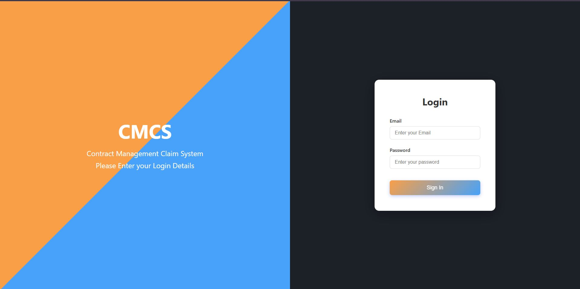
The Login View
The Login View would take the entered email and password and link it with the database if there is a match the user would have successfully logged in

Slide 5
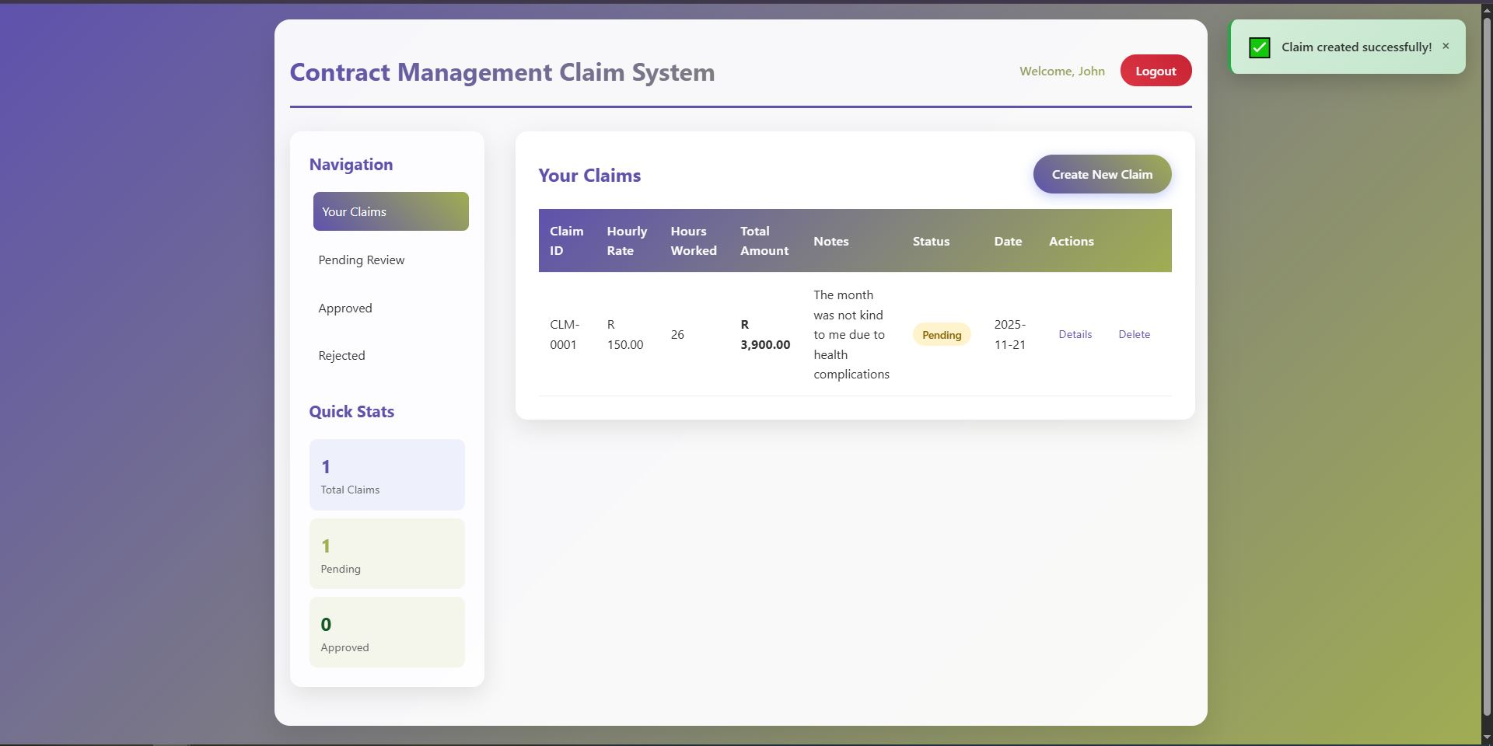
The Lecturer’s View
The Lecturer’s View is the place where Lecturer’s can make their claims and track it progress. They can it status whether it is rejected, approved or pending. They can also view details to see if they got something wrong and they can delete the claim when they feel is necessary.

Slide 6
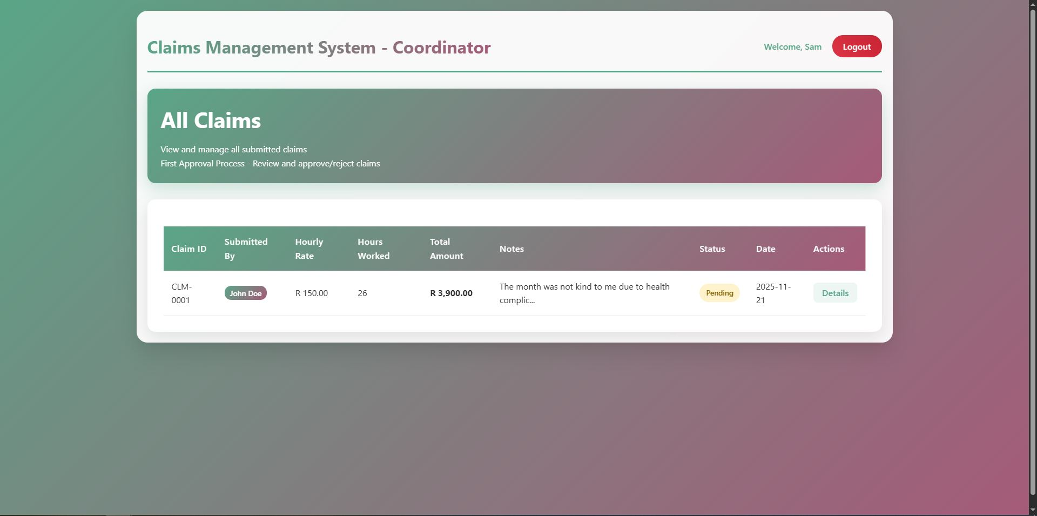
Coordinator’s View
The Coordinator View is where the Programme Coordinator can view the claims submitted by the Lecturer and determine if the claim should move up the chain to the Academic Manager where he gives the final Approval or Rejection. The Coordinator can download documents associated with claim and view extra details of the claim

Slide 7

Manager’s View
The Manager’s View is similar to the Coordinator View where the Academic Manager can view claims that have been verified by the Programme Coordinator. The same functionality are here except when the manager approves the claim it is official approved and then shows the Lecturer its approval status and moving onto the HR.

Slide 8
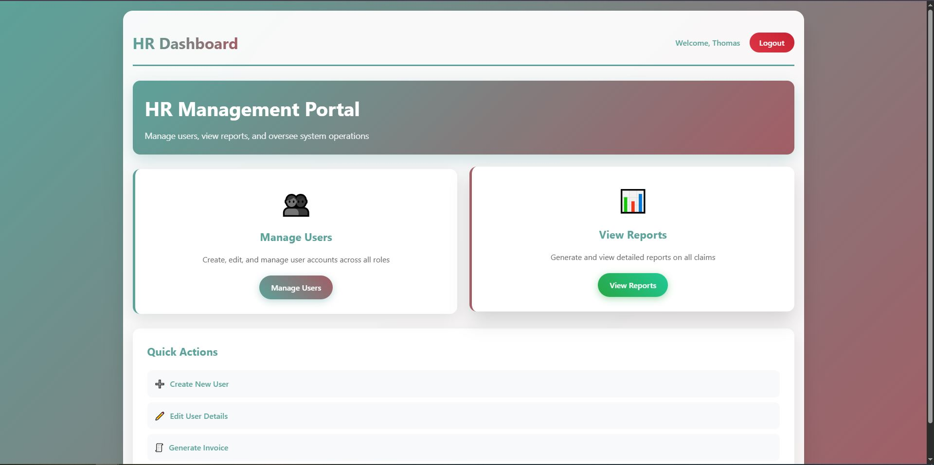
The HR’s View
The HR’s view is the place where HR personnel perform their duties, adding and editing User profiles (which influence the database) as well as viewing the reports which show all claims and when they are approved HR can generate an invoice for the claim.

Slide 9

Feedback Changes
With the POE ending in the final POE version there were needed feedback changes for Part 3 that were brought up in Part 2 by the Lecturer.
Those being:
Colour Coordination was added to all views involving the Claim Status to add more readability and present Clear Information.
The storage folder was moved to a Document folder within the App_Data folder which is within the Project PROG6212_POE and securing methods were added to prevent unauthorized access to files.
Unit Tests were checked and have been believed to fixed in properly included in the GitHub Repository (tested by fellow Students).
All commits made for Part 3 have been more descriptive in their messages and explanatory in the changes.

Slide 10
System Tools used to make this application
Databases
sessions
With Entity Framework Core the database is easily created and helps to store claims and users. With EF Core models can be used to set a database table and allow the use of DbContext which helps to set database properties and can allow for seeding data entries.
With Sessions we can set a temporary storage area to hold information while using the web app like User information. With it we can set User names so that the program can name the user as well as set user specific data within the code.

Slide 11
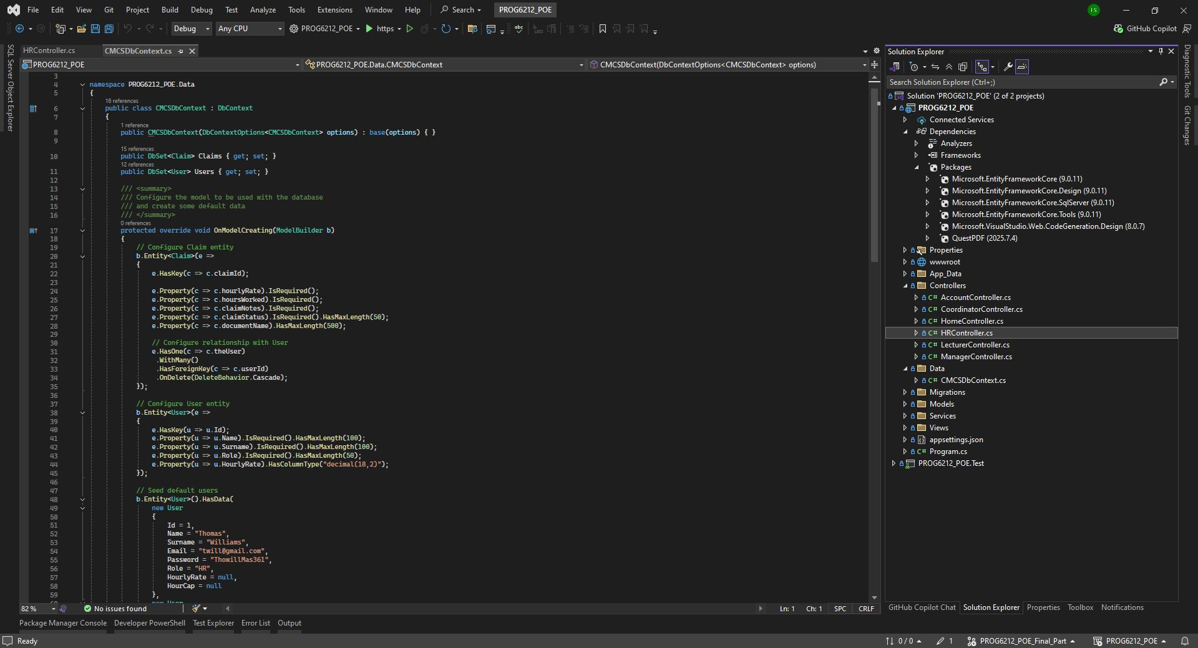
Database (EF Core)
Database code from my program
This image is part of my DbContext file which helps to set the properties and interactions of the database as well as seeding data within the User table of the Main database. With this we set what is required in a table and set relationships that we could like with the POE the User and Claim have one-to-many relationship where user will have multiple claims and claims will have only one user.

Slide 12
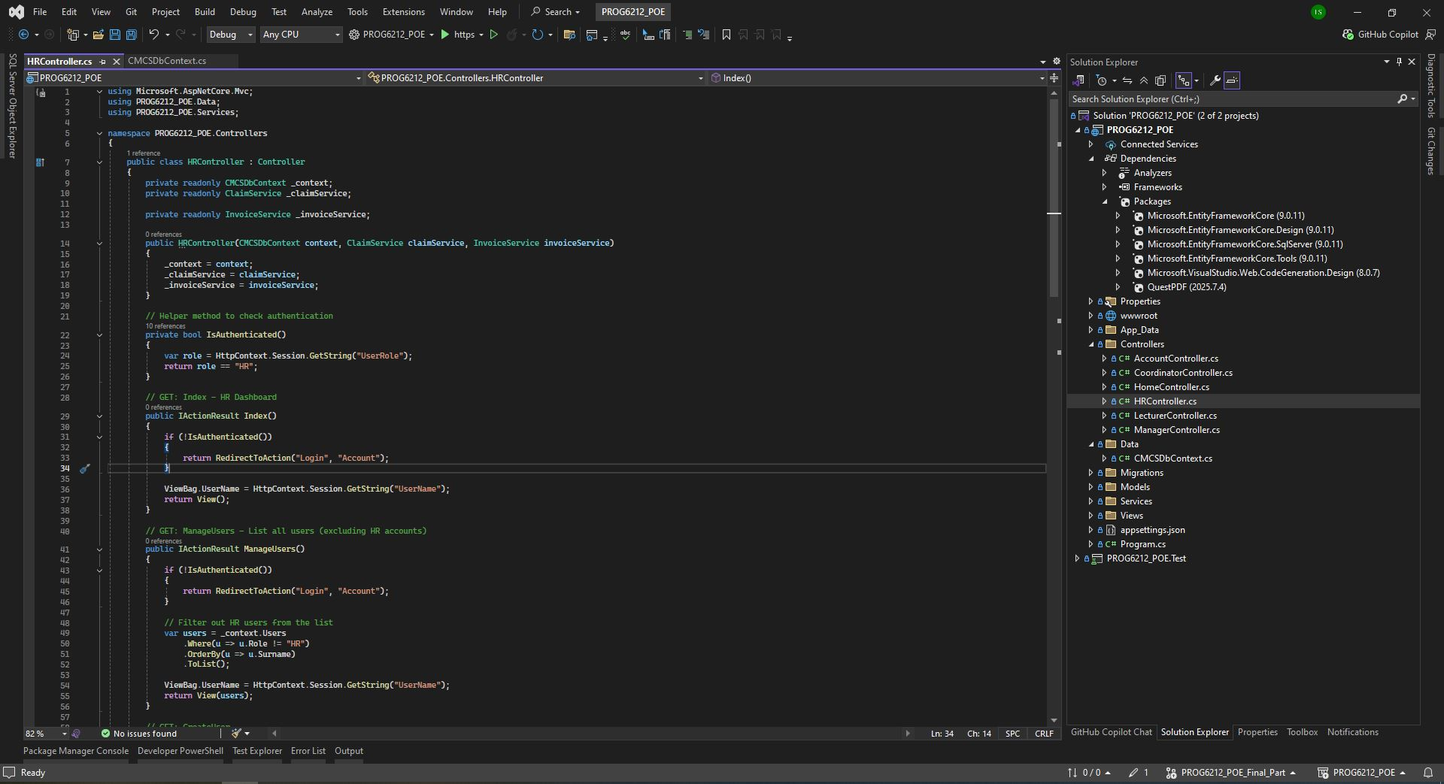
Sessions
Session code from my program
This code section is just a showcase of the use of sessions. This code checks the current session data which is set from the login view to match the user database table to make sure that when a user logs in they are checked in the view whether they are authorized to view this page.

Slide 13
How about a video demonstration of the application
Let’s move from this slideshow explanation to my video explanation that is available with this YouTube Link:
https://youtu.be/2eQNJYsmzCc

